Slide 1
INF10025
Data Management and Analytics
Lecture 7 – Part 3
Group By / Having
MS Access & SQL

Slide 2
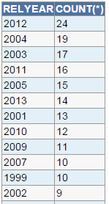
SQL Group By
Non Aggregate Expression
Aggregate Expression
The Group By clause must always be used in
conjunction with an aggregate expression
whenever you want a non aggregate expression
in the select clause
  Add a non-aggregate expression to both
    The Select clause
    The Group By clause
  Add an aggregate expression only to the:
    The Select clause
SELECT relyear, COUNT(*)
FROM movie
GROUP BY relyear

Slide 3
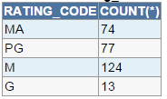
SQL Group By
We want count how many movies exist for each rating code
Add the column rating_code (non-aggregate expression) to both:
    The Select clause
    The Group By clause
Add the COUNT(*) (aggregate expression) to only the:
    The Select clause
SELECT rating_code, COUNT(*)
FROM movie
GROUP BY rating_code

Slide 4
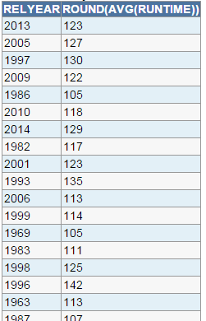
SQL Group By
We want to list the average running length
of movies for each year
Add the column relyear (non-aggregate expression)
to both:
    The Select clause
    The Group By clause
Add the AVG(runtime) (aggregate expression) to
only the:
    The Select clause
Notice how the result set is displayed in
random year sequence. Not user friendly.
SELECT relyear, AVG(runtime)
FROM movie
GROUP BY relyear

Slide 5
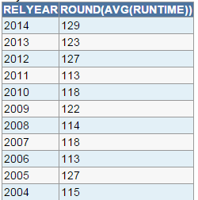
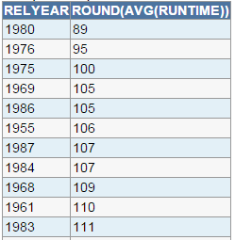
SQL Group By
The ORDER BY clause causes rows in the result set to be sequenced by a specified column.
SELECT relyear, AVG(runtime)
FROM movie
GROUP BY relyear
ORDER BY relyear DESC
SELECT relyear, AVG(runtime)
FROM movie
GROUP BY relyear
ORDER BY AVG(runtime) ASC

Slide 6
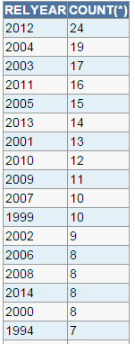
SQL Group By
Using the Column Number
in the Order By clause
SELECT relyear, COUNT(*)
FROM movie
GROUP BY relyear
ORDER BY 2 DESC
The 2 refers to the 2nd column of the result set.
So the rows appear in descending count(*) sequence

Slide 7
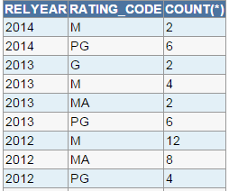
SQL Group By
Consider this result set
  It shows a count of movies by year
  Within each year
    It shows a count of movies
    by rating_code
So we can see that in 2013:
  There were 4 'M' movies
  There were 6 'PG' movies
This result is similar to the similar to previous group by results.
However this example has
  two non-aggregate expressions
  one aggregate expression

Slide 8
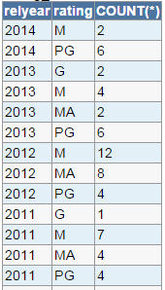
SQL Group By with multiple non-aggregate columns
We want the count of each rating type in each year
Add relyear, rating_code (non-aggregate expressions)
to both:
    The Select clause
    The Group By clause
Add COUNT(*) (aggregate expression) to ONLY the:
    The Select clause
SELECT relyear, rating_code, COUNT(*)
FROM movie
GROUP BY relyear, rating_code
ORDER BY relyear, rating_code

Slide 9
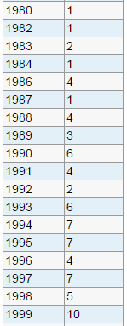
SQL Group By
Consider this SQL statement
The result set lists the number of movies per year
Many of the years have a small number of movies
Suppose we are only interested in only years that have a total of 5 or more movies
SELECT relyear, COUNT(*)
FROM movie
GROUP BY relyear

Slide 10
SQL Group By
SELECT relyear, COUNT(*)
FROM movie
GROUP BY relyear
So we only want to keep rows that have a
COUNT(*) value >= 5 in the result set
We want to keep the rows that are not crossed out

Slide 11
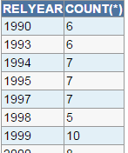
SQL Group By Having
The Having clause only keeps a row in the result set
if a value that meets a specified criteria
Usage:
  Copy the aggregate expression
  in the Select clause and place it in the
  Having clause
    Count(*)
SELECT relyear, COUNT(*)
FROM movie
GROUP BY relyear
HAVING COUNT(*) >= 5

Slide 12
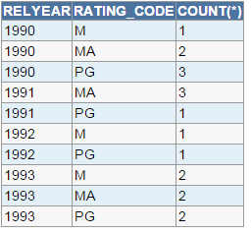
SQL Group By Having Example 2
This example has a WHERE clause
Only movie rows in years 1990-93 are selected
The result has 10 rows.
The WHERE clause specifies which
rows from the MOVIE table will be
used to build the result set
SELECT relyear, rating_code, COUNT(*)
FROM movie
WHERE relyear >= 1990
AND relyear <= 1993
GROUP BY relyear, rating_code
ORDER BY 1, 2

Slide 13
SQL Group By Having Example 2
This example now has a HAVING clause
The having clause evaluates rows in the result set using the Aggregate Count(*) expression
The HAVING clause specifies which
rows from the result set are kept
or eliminated.
SELECT relyear, rating_code, COUNT(*)
FROM movie
WHERE relyear >= 1990
AND relyear <= 1993
GROUP BY relyear, rating_code
HAVING COUNT(*) > 1
ORDER BY 1, 2

Slide 14

SQL Typical Error Message
Most Aggregate expressions must have a matching Group By clause
Students often encounter the
"Not a single-group group function error"
when using aggregate expressions
If you see this error, check if you are using non-aggregate and aggregate expressions correctly
SELECT relyear, COUNT(*)
FROM movie
GROUP BY relyear
SELECT relyear, COUNT(*)
FROM movie
✓
✗

Slide 15
MS Access and SQL
You can use SQL in MS Access
Steps:
  Create a Query by Design
  Do not add any table to the query
  Click the SQL icon at the bottom right of the design window
  Type your SQL
  Click the View icon on the menu bar to view the Query By Design window / run the query

Slide 16
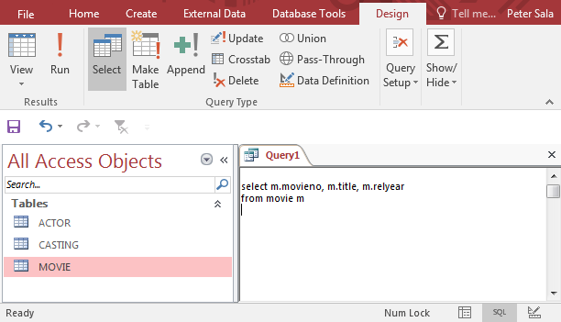
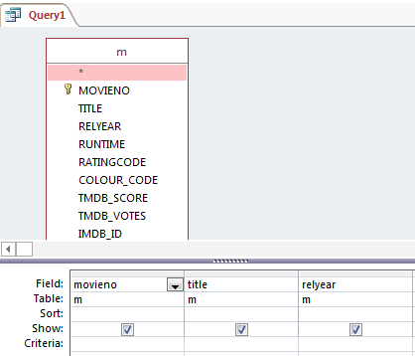
MS Access and SQL
You can use SQL in MS Access

Slide 17
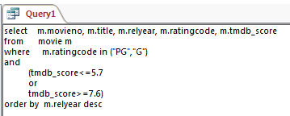
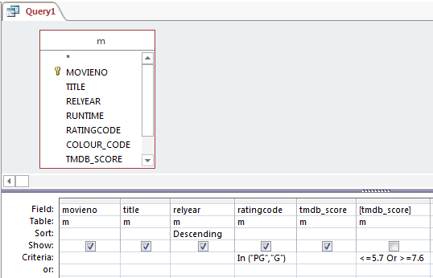

MS Access and SQL
A more complex example:
If you run the query and then return to the SQL window, the query will often be reformatted – usually with more brackets added to the code.

Slide 18
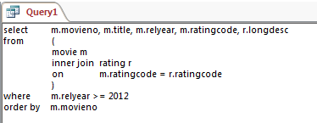
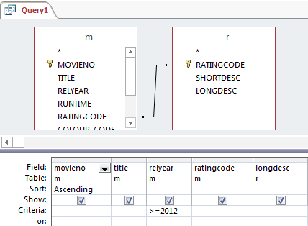
MS Access and SQL
An example with inner joins:
When you use INNER JOINS in you Access SQL, you must enclose the table names and join clauses with brackets.
    Always true, if two inner joins are used
    Sometimes true is one inner join is used.

Slide 19
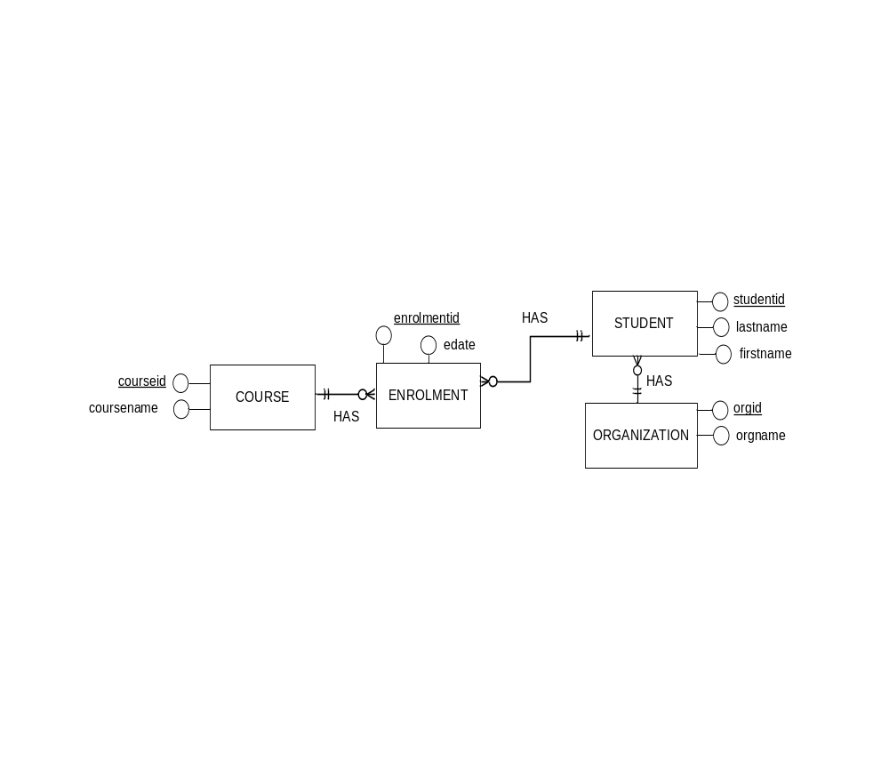
MS Access and SQL
Example with four tables and three inner joins:
SELECT E.enrolmentid, S.firstname, S.lastname, C.coursename, O.orgname
FROM ( ( (enrolment E
INNER JOIN student S ON E.studentid = S.studentid )
INNER JOIN course C ON E.courseid = C.courseid )
INNER JOIN organization O ON S.orgid = O.orgid )

